Slide 1
Epileptic Seizure Localization from EEG Signals
PROJECT PRESENTATION
Guide:
Dr. Sminu Izudheen
Professor
Dept. of CSE
RSET
Niyatha V S
Paul Allen
Powell Moothedan
Rose Jacob

Slide 2
Contents
Introduction
Problem definition
Purpose & need
Project objective
Literature review
Proposed method
System architecture
Sequence diagram
Each module in detail
Assumptions
Work Breakdown
Hardware & Software requirements
Gantt chart
Risk & Challenges
Expected output
Output
Conclusion
Future work
References

Slide 3
Introduction
Epilepsy is a neurological condition characterized by erratic signals from groups of neurons in the brain, leading to seizures, assessed using EEG.
Examining the 10 to 15 hours of EEG data through visual analysis is time-consuming
Our software tool streamlines this process for neurologists
Enables automated localisation of seizure
Provides interpretation to the decision made by the CNN model

Slide 4
Introduction
To get a better understanding:
1 hour EEG data = 1 * 60 * 60 * 256
=9,21,600 data points = 3600 sheets
40 hours EEG data = 9,21,600 * 40
= 3,68,64,000 data points = 1,44,000 sheets

Slide 5
Problem Definition
Manual Analysis of EEG Signals: Epileptic seizures are diagnosed using EEG recordings, but analyzing long hours of EEG signals is time-consuming and prone to human error.
Automated Detection: Using Convolutional Neural Networks (CNNs) to automate seizure localization offers a solution to speed up diagnosis.
Explainability in AI: Providing understandable explanations for the model's decisions is essential for clinicians to trust the automated system.

Slide 6
Project Objective
Build a CNN-based system for automatic seizure localization from EEG signals.
Integrate XAI Techniques:
SHAP to explain the contribution of each feature to the final decision.
LIME for local interpretability of the model’s predictions.
Provide Clinically Relevant Insights into seizure activities from EEG data.
Target: >90% accuracy in detecting seizures while ensuring model transparency.

Slide 7
Literature Survey
PAPER | ADVANTAGES | DISADVANTAGES
Schirrmeister RT, Gemein LA, Eggensperger K, Hutter F, Ball T. XAI4EEG: Spectral and Spatio-Temporal Explanation of Deep Learning-Based Seizure Detection in EEG Time Series | + Provides consistent and accurate attributions + Model-agnostic; works with any machine learning model + Offers both local and global interpretability | - Computationally expensive for large datasets or complex models - Difficult to scale for real-time applications - Can be challenging to interpret in high-dimensional data

Slide 8
Literature Survey
PAPER | ADVANTAGES | DISADVANTAGES
Ribeiro MT, Singh S, Guestrin C. "Why Should I Trust You?": Explaining the Predictions of Any Classifier. In: Proceedings of the 22nd ACM SIGKDD International Conference on Knowledge Discovery and Data Mining (KDD '16). New York, NY: ACM; 2016. p. 1135–44. doi:10.1145/2939672 | + Model-agnostic; can explain any machine learning model + Fast and efficient for local explanations + Provides simple and interpretable explanations | - Sensitive to sampling; results may vary across different runs - Struggles with explaining highly complex or non-linear models - Limited global interpretability; focuses mainly on local explanations

Slide 9
Literature Survey
PAPER | ADVANTAGES | DISADVANTAGES
Inbaraj XA, Jeng JH. Mask-GradCAM: Object Identification and Localization of Visual Presentation for Deep Convolutional Network | + Highly effective for visualizing deep learning models, particularly CNNs + Produces class-specific heatmaps to show important regions in input data + Intuitive for image-related tasks and visual data | - Primarily designed for convolutional neural networks (CNNs); limited generalization to other model types - Resolution of heatmaps can be coarse - Difficult to apply to non-visual tasks like text or tabular data

Slide 10
Proposed Method
Data Collection: Acquire EEG recordings from publicly available datasets focused on pediatric epilepsy patients.
Preprocessing: Clean the raw EEG signals by removing artifacts and irrelevant channels (e.g., ECG, empty or redundant columns).
Feature Extraction: Extract frequency-domain features, especially from clinically relevant bands and investigate changes in power or patterns that may precede seizure onset.
Thresholding Mechanism: Employ statistical or signal-based methods to set dynamic thresholds and explore automated strategies to replace manual rule-setting for seizure detection.

Slide 11
Proposed Method
Model Building: Train a deep learning model (e.g., CNN) to classify seizure and non-seizure events based on extracted features.
Explainability Integration: Integrate SHAP and LIME to interpret model decisions and localize contributing EEG channels to provide transparent decision support for neurologists.
Clinical Alignment: Design the approach to aid neurologists by emphasizing interpretability and visual diagnostics to build clinical trust.

Slide 12
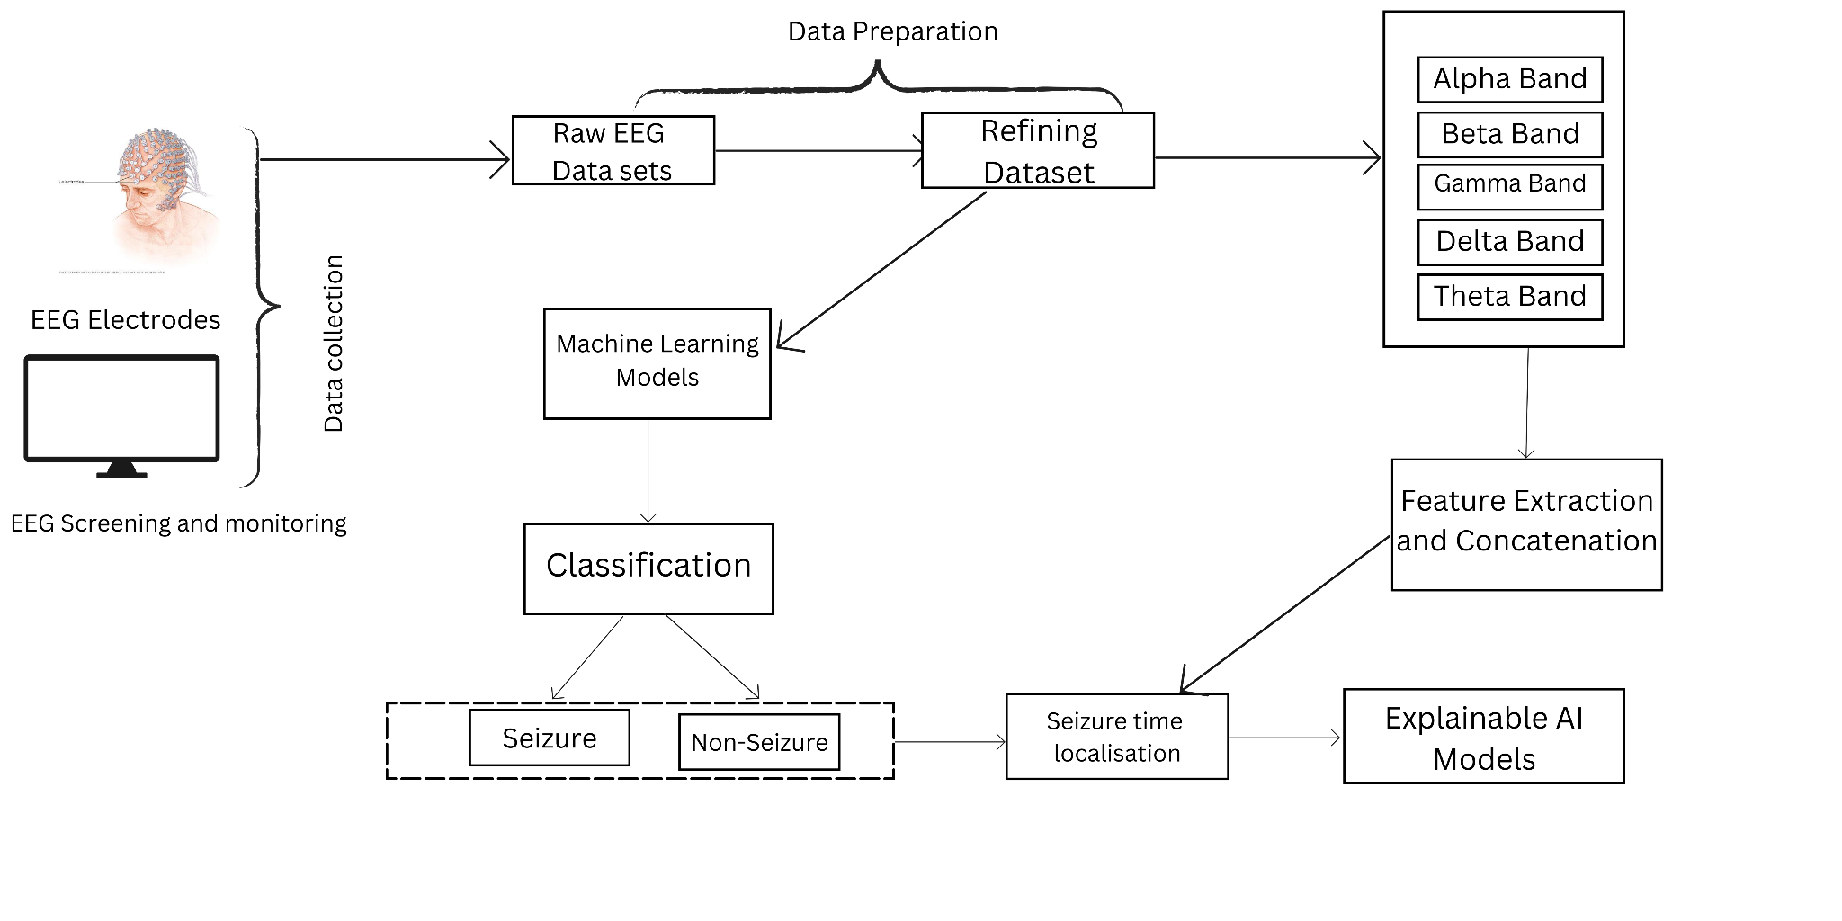
Architecture Diagram

Slide 13
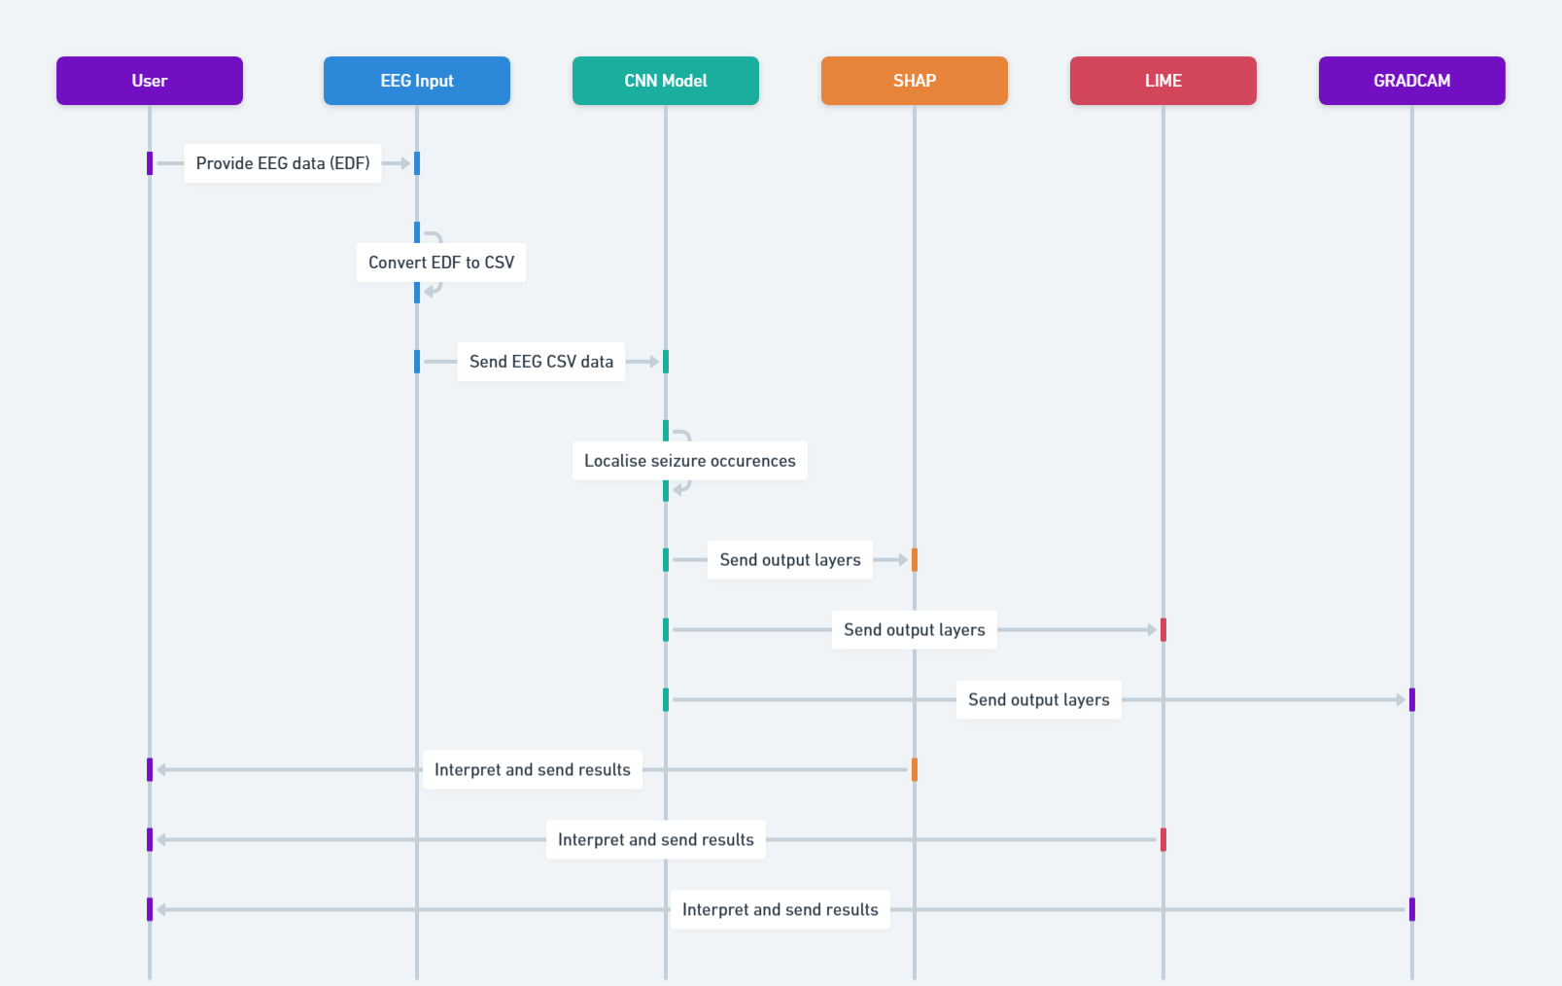
Sequence Diagram

Slide 14
Dataset used
Utilizes the CHB-MIT dataset, collected from the Children's Hospital at Boston, which consists of EEG recordings.
The EEG recordings are grouped into 23 cases, collected from 22 subjects (5 males, ages 3–22; and 17 females, ages 1.5–19) and it includes pediatric subjects with intractable seizures.
The sampling rate of the signals is 256 Hz . For most of the cases, 23 EEG channels are present and the .edf files contain exactly one hour of digitized EEG signals.
The International 10-20 system of EEG electrode positions and nomenclature was used for these recordings.
Source: https://physionet.org/content/chbmit/1.0.0/

Slide 15
Data Preprocessing
The .edf files were converted to .csv files where the columns represent the electrode potential values and the rows represent the time samples at a sampling rate of 256 Hz
During preprocessing stage, the csv files are annotated as 1 where a seizure event was recorded in the summary files provided and 0 where non seizure events were recorded.

Slide 16
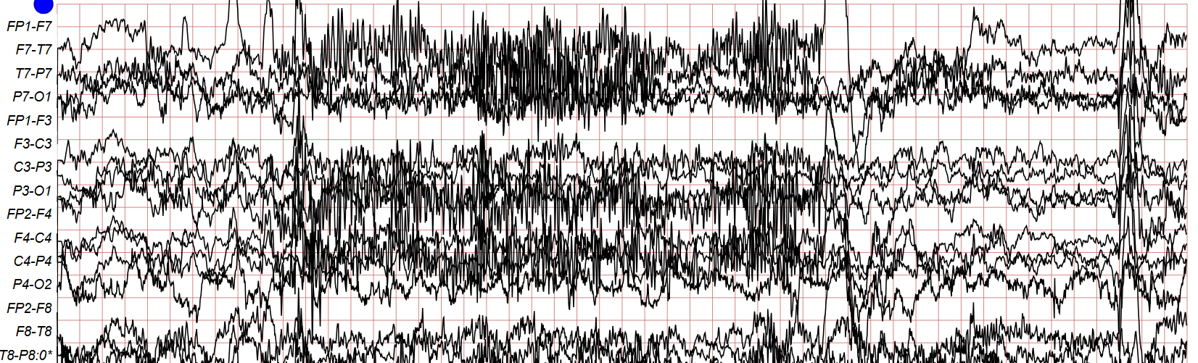
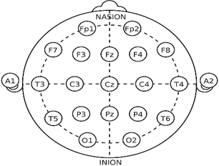
10 - 20 standard electrode system
Input .edf file

Slide 17
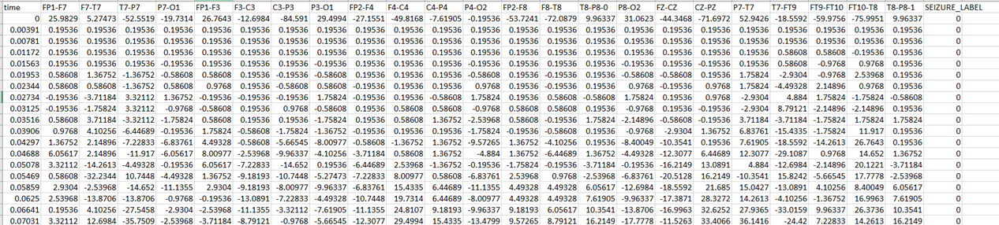
Annotated patient .csv files
Electrodes as per the 10 - 20 international standard
Seizure label as 0 or 1
Time samples at sampling rate of 256 Hz which means each 1 second is divided into 256 samples
Electrode potential value

Slide 18
Feature Extraction
Considers 30 one second long preictal frames and one second ictal frames
Relative power is calculated by integrating the Power Spectral Density within the specified frequency bands and normalizing it by the total power across the entire frequency range
Analysis of particularly the power spectral density of alpha and delta waves revealed that the relative power in the alpha band was higher during the preictal phase and the alpha waves convert to delta waves during the ictal phase, also known as the alpha slowing phenomenon
This approach will help in localising the origin of the seizure spikes by considering interframe dependencies

Slide 19
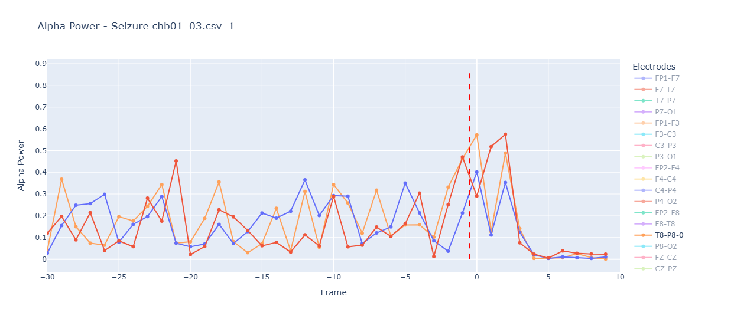
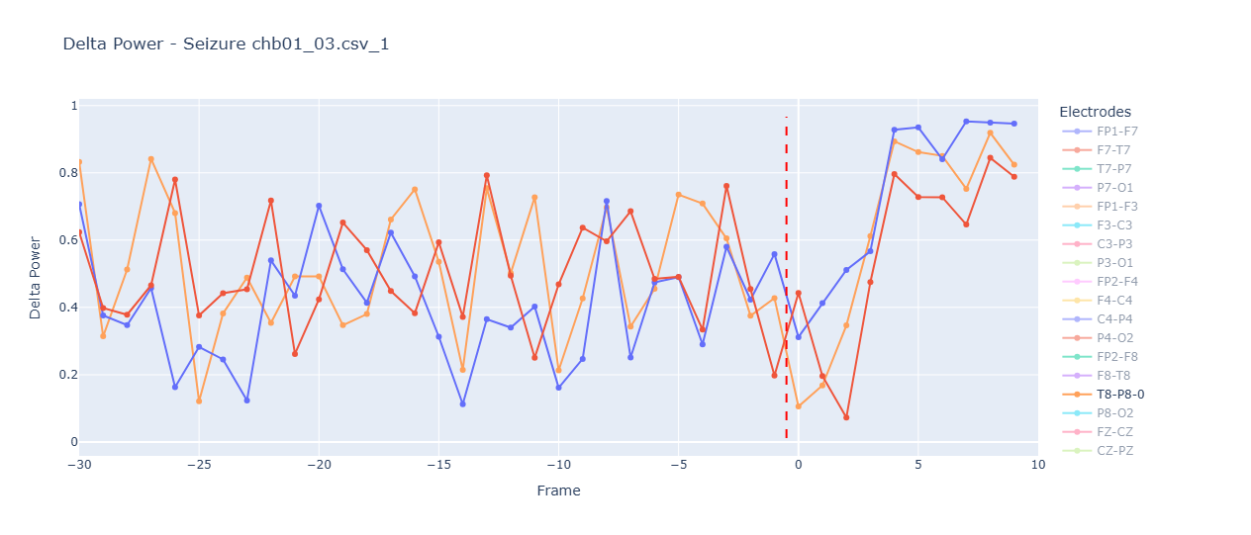
Feature Extraction

Slide 20
Patient Specific CNN Model
Convolutional Blocks (Feature Extraction)
Convolutional Blocks (Feature Extraction)
Conv2D (32 filters, 3x3)
Extracts low-level spatial features like edges or activations from EEG frames.
BatchNormalization
Stabilizes learning and speeds up convergence.
MaxPooling2D
Reduces spatial dimensions, preserves dominant features.
Dropout
Prevents overfitting by randomly deactivating neurons during training.

Slide 21
Patient Specific CNN Model
Deeper Feature Extraction Layers
Conv2D (64 filters)
Learns more complex patterns in reduced spatial dimensions.
BatchNormalization + MaxPooling + Dropout
Repeated combination to normalize, downsample, and regularize the data.
Conv2D (128 filters)
Final convolutional block for rich, abstract feature learning.
BatchNormalization + MaxPooling2D + Dropout
Final feature compression and regularization layer.

Slide 22
Patient Specific CNN Model
Dense Layers (Classification Head)
Flatten
Converts 2D feature maps to 1D vector for dense layers.
Dense (128 units)
Fully connected layer for learning nonlinear combinations of features.
Dropout
Further regularization.
Dense (1 unit, output layer)
Final prediction – seizure (1) or non-seizure (0).

Slide 23
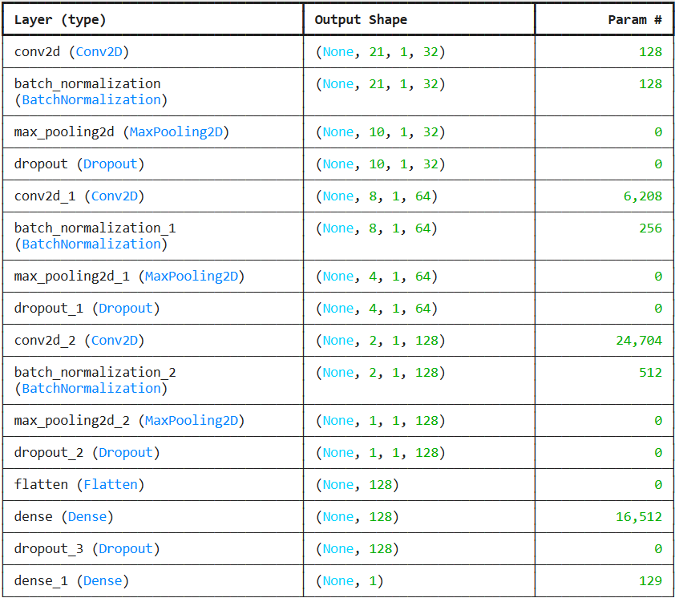

Slide 24
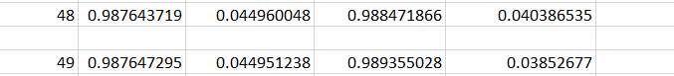
Epoch
Training accuracy
Training loss
Validation accuracy
Validation loss

Slide 25
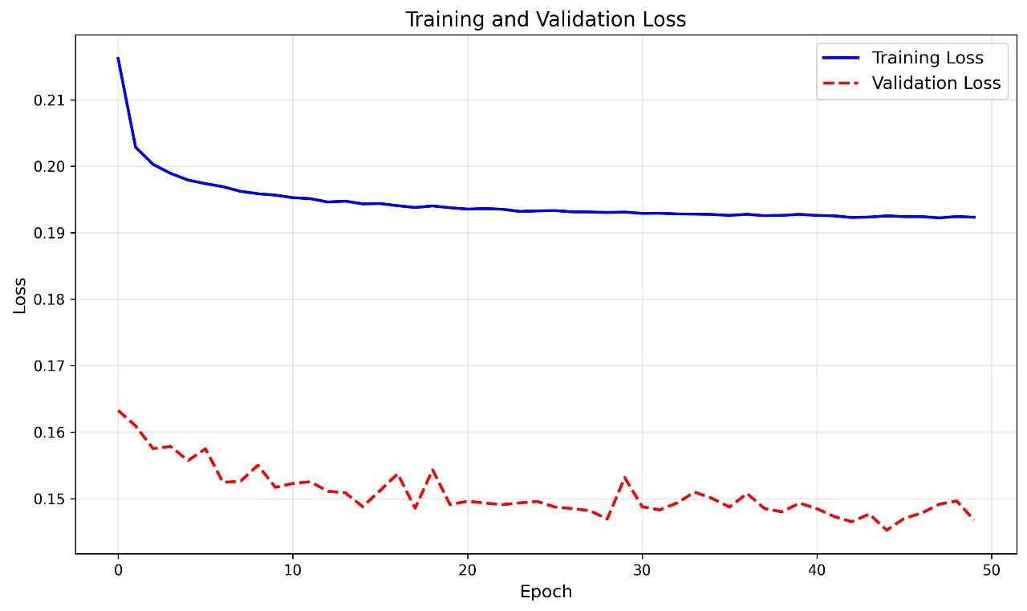
Loss curve

Slide 26
Automation of Threshold Fixing for Time Prediction Algorithm
The CNN model threshold (like 0.5) is used for binary classification of frames, but is not optimal for temporal localization of seizures.
Seizure dynamics vary between patients: onset pattern, duration, and signal strength differ.
A global threshold may miss weak seizures or falsely detect strong noise.
Hence, custom thresholds per patient improve prediction reliability.
Manual threshold tuning is time-consuming and prone to bias.
EEG patterns vary by age, condition, and electrode placement.
Automation ensures adaptive, robust, and personalized seizure time prediction without human supervision.
Our approach uses a data-driven method for threshold calibration.

Slide 27
Automation of Threshold Fixing for Time Prediction Algorithm
Apply a sliding window of size 30 and stride size 1 across the EEG to compute the Delta-Alpha Ratio (D-A-R) at each second.
It had been observed that the D-A-R peaks coincide with seizure periods.
It had also been observed that the D-A-R from peak to actual seizure onset ≥ 1.9.
This gives a possible seizure onset time window.
From the predicted seizure onset, we consider:
30 preictal frames (1 second each, before onset).
10 ictal frames (1 second each, after onset).
These 40 frames are used to extract delta values for statistical modeling.

Slide 28
Automation of Threshold Fixing for Time Prediction Algorithm
The following statistical methods are applied to these values:
MAD (Median Absolute Deviation):
A robust dispersion measure.
MAD Threshold = median + (scale factor × MAD)
where, MAD = median(|Xi − median(X)|)

Slide 29
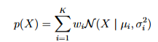
Automation of Threshold Fixing for Time Prediction Algorithm
GMM (Gaussian Mixture Model):
A GMM with two components is fitted on the delta values.
The minimum of the GMM means is taken as a candidate threshold, assuming it represents the preictal (non-seizure) cluster.
p(X) - probability density
K - number of Gaussian components
wi - weight of i th component
μ - center of the ith gaussian
𝜎 - spread of the component

Slide 30
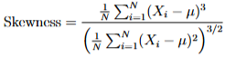
Automation of Threshold Fixing for Time Prediction Algorithm
IQR (Interquartile Range):
Captures spread by computing Q1 and Q3.
IQR = Q3 − Q1, where Q3 is 75th percentile and Q1 is 25th percentile
Skewness:
A measure of signal distribution asymmetry that affects the threshold’s appropriate shift.
Xi is the EEG value
μ is the mean
N is the number of samples.

Slide 31
Automation of Threshold Fixing for Time Prediction Algorithm
The base threshold is adaptively tuned by adding an auto-correction factor that is calculated using these features:
Correction = 0.05 · log(1 + IQR) · tanh(Skewness)
The final threshold is calculated as,
Final Threshold = α · TGMM + (1 − α) · TMAD + Correction
where, α is the weight parameter balancing GMM and MAD thresholds

Slide 32
Automation of Threshold Fixing for Time Prediction Algorithm
After identifying a statistical threshold using preictal Delta-Alpha-Ratio (DAR) data through GMM, MAD, IQR, and kurtosis ensemble methods, this calibrated threshold is used to refine the CNN model's output.
The CNN model predicts seizure likelihood for each EEG frame.
Instead of using an arbitrary fixed threshold (e.g., 0.5), the calibrated, patient-specific threshold is applied to convert continuous prediction scores into binary labels (0 or 1).

Slide 33
Automation of Threshold Fixing for Time Prediction Algorithm
This ensures:
Alignment between DAR-based seizure zones and CNN predictions
Adaptability across patients with varying EEG dynamics
Minimized false alarms and improved temporal accuracy
Once predictions are binarized using this threshold:
Consecutive or closely spaced seizure-labeled frames are merged
Short noisy predictions (e.g., <10 seconds) are discarded
The final output is a list of precise seizure intervals

Slide 34
Patient number | Threshold calculated using the statistical approach
Patient 1 | 0.76
Patient 3 | 0.73
Patient 5 | 0.89
Patient 11 | 0.73
Patient 22 | 0.78

Slide 35
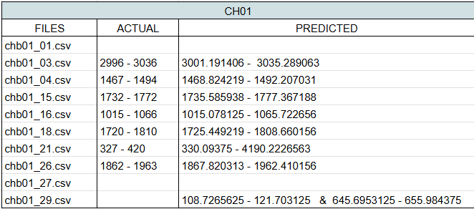
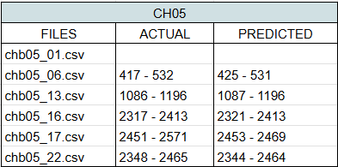
Time prediction made by using the threshold that was calculated using statistical methods which was 0.76 for patient 1
Time prediction made by using the threshold that was calculated using statistical methods which was 0.89 for patient 5

Slide 36
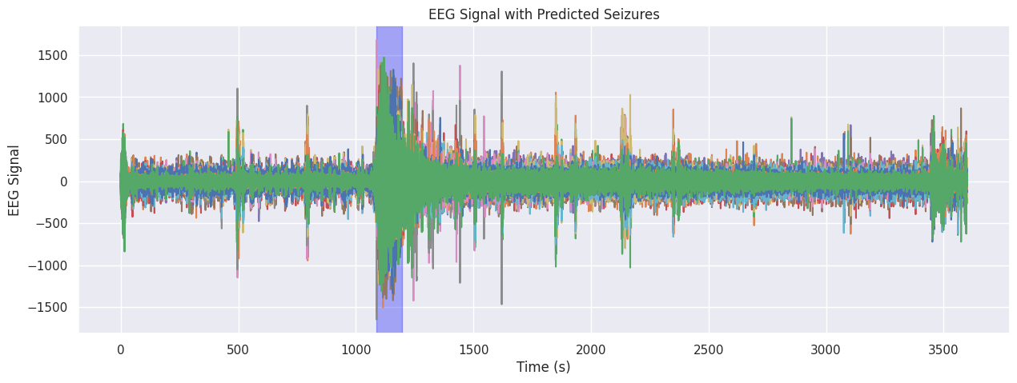
Plot with the predicted time highlighted in blue

Slide 37
Explainable AI Model - SHAP
SHAP (SHapley Additive exPlanations) is a model-agnostic interpretability technique based on cooperative game theory. It assigns each feature an importance value for a particular prediction.
It provides global and local insights into model behavior while maintaining consistency and fairness in feature attribution.
SHAP calculates the marginal contribution of each feature by evaluating all possible combinations (feature coalitions), ensuring each feature’s impact is fairly represented.
By aggregating SHAP values over many samples, we obtain a global view of which features consistently influence model predictions.
Helps identify most influential EEG biomarkers or frequency bands in seizure prediction.
SHAP KernelExplainer was used in this study as a model-agnostic approach to interpret the CNN's predictions.

Slide 38
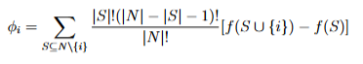
Explainable AI Model - SHAP
Interpreting the Plot:
X-axis (SHAP value) shows how much that feature pushes the prediction higher or lower.
Color gradient (e.g., red to blue) represents the original feature value.
A wider spread → higher impact; clustering near zero → minimal influence.
SHAP allows doctors to see global trends across patients.

Slide 39
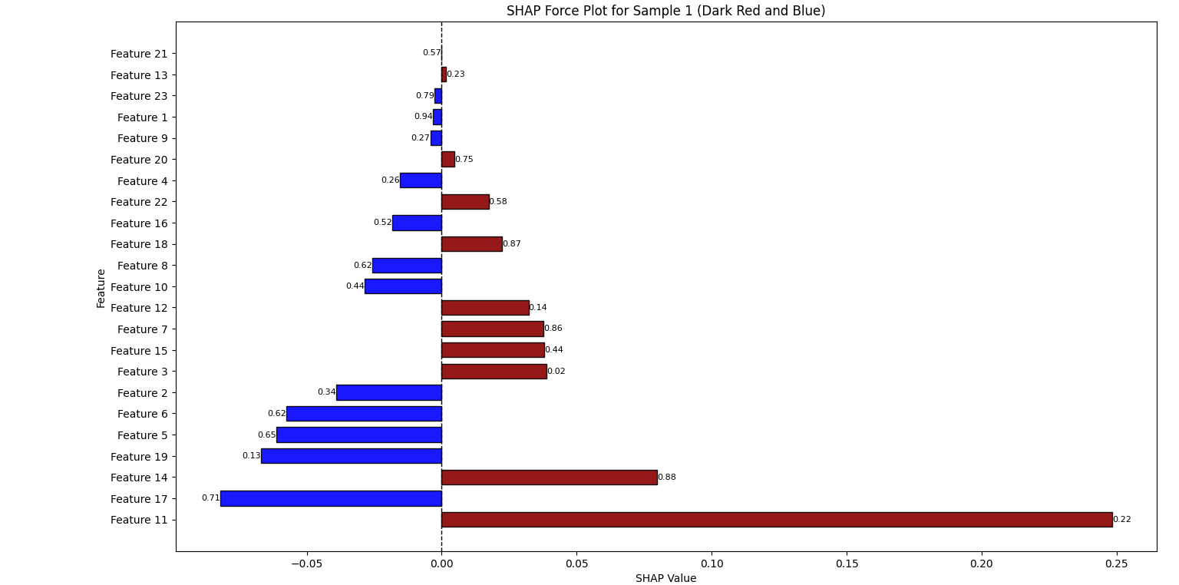
Feature 11 - C4-P4 is seen to have the most contribution to the final output of the model

Slide 40
Explainable AI Model - LIME
SHAP gives an overview of how each channel behaves overall.
LIME allows case-by-case breakdowns, mimicking a doctor analyzing an individual patient's snapshot.
Explains the prediction of an individual sample by approximating the model locally.
Perturbs the input sample slightly (e.g., mask or modify EEG channels).
Observes model predictions for these perturbed versions.
Fit a simple, interpretable model (e.g., linear regression) on the perturbed data and predictions.

Slide 41
Explainable AI Model - LIME
This surrogate model approximates the black-box model in the vicinity of the original input.
Explains what features (channels) most influenced the prediction for this specific time window.
Bar plot output:
Features (EEG channels) are shown with weights.
Positive weight → feature supports the model’s prediction (e.g., seizure).
Negative weight → feature pushes against the prediction.

Slide 42
Explainable AI Model - LIME
Magnitude of weight shows how strongly the feature impacted the output.
Highlights which channels are most significant at a given moment.
Helps validate whether the model aligns with known seizure patterns.
Doctors can visualize temporal-spatial patterns of seizures and verify if model reasoning makes clinical sense.

Slide 43
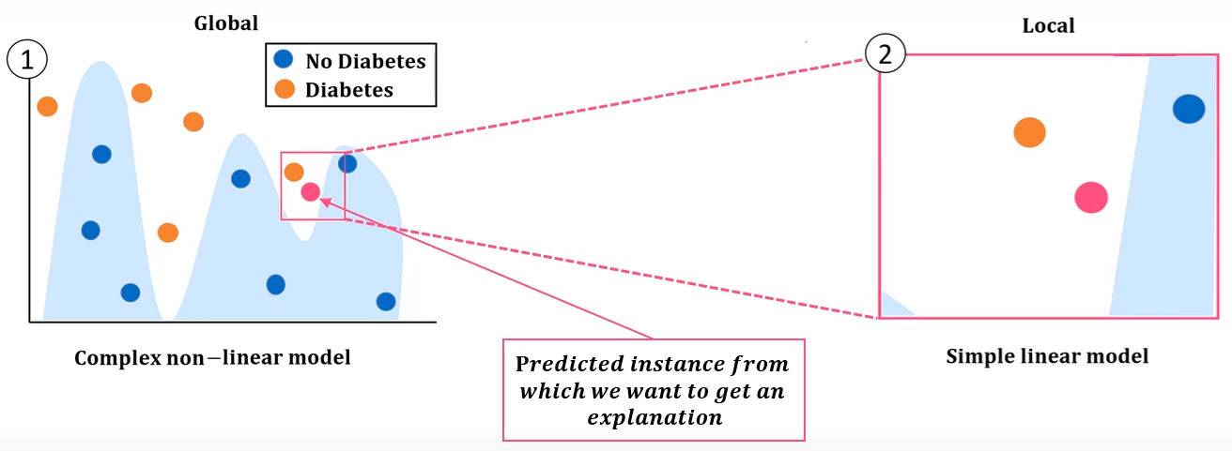

Slide 44
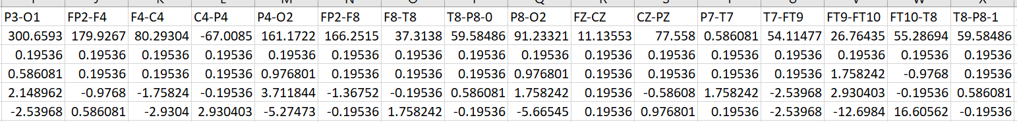
Input Data

Slide 45
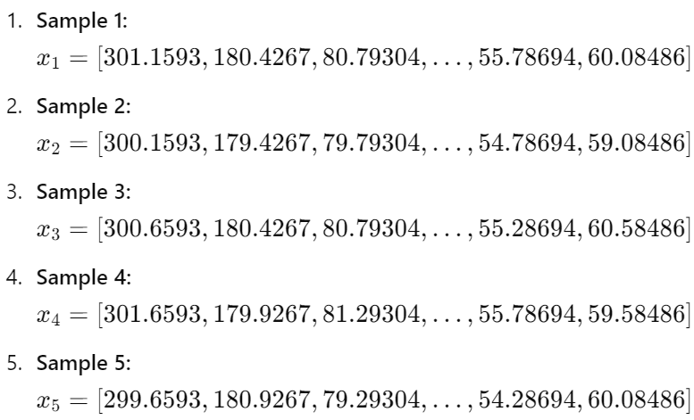
Perturbate

Slide 46
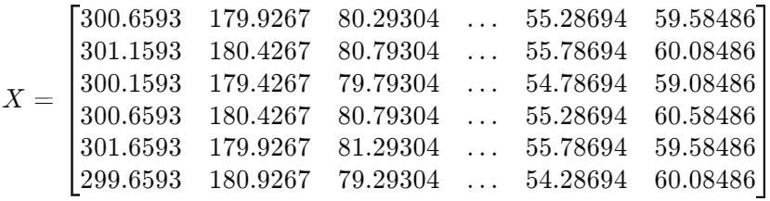
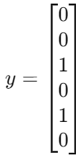
Perturbate

Slide 47
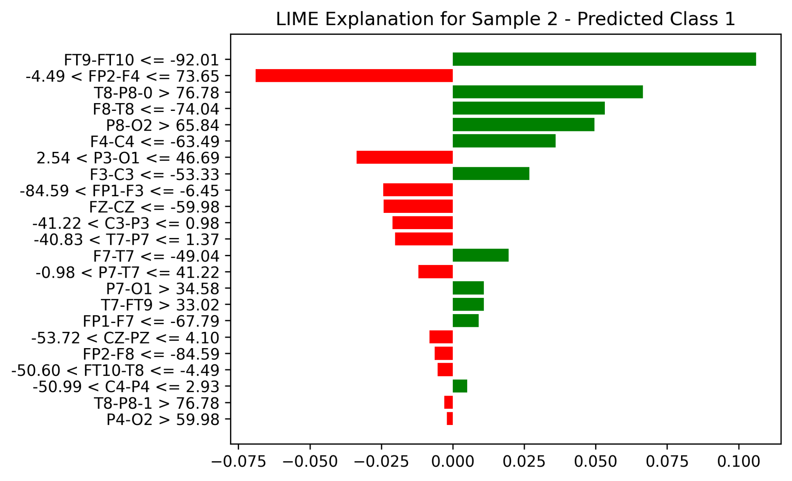
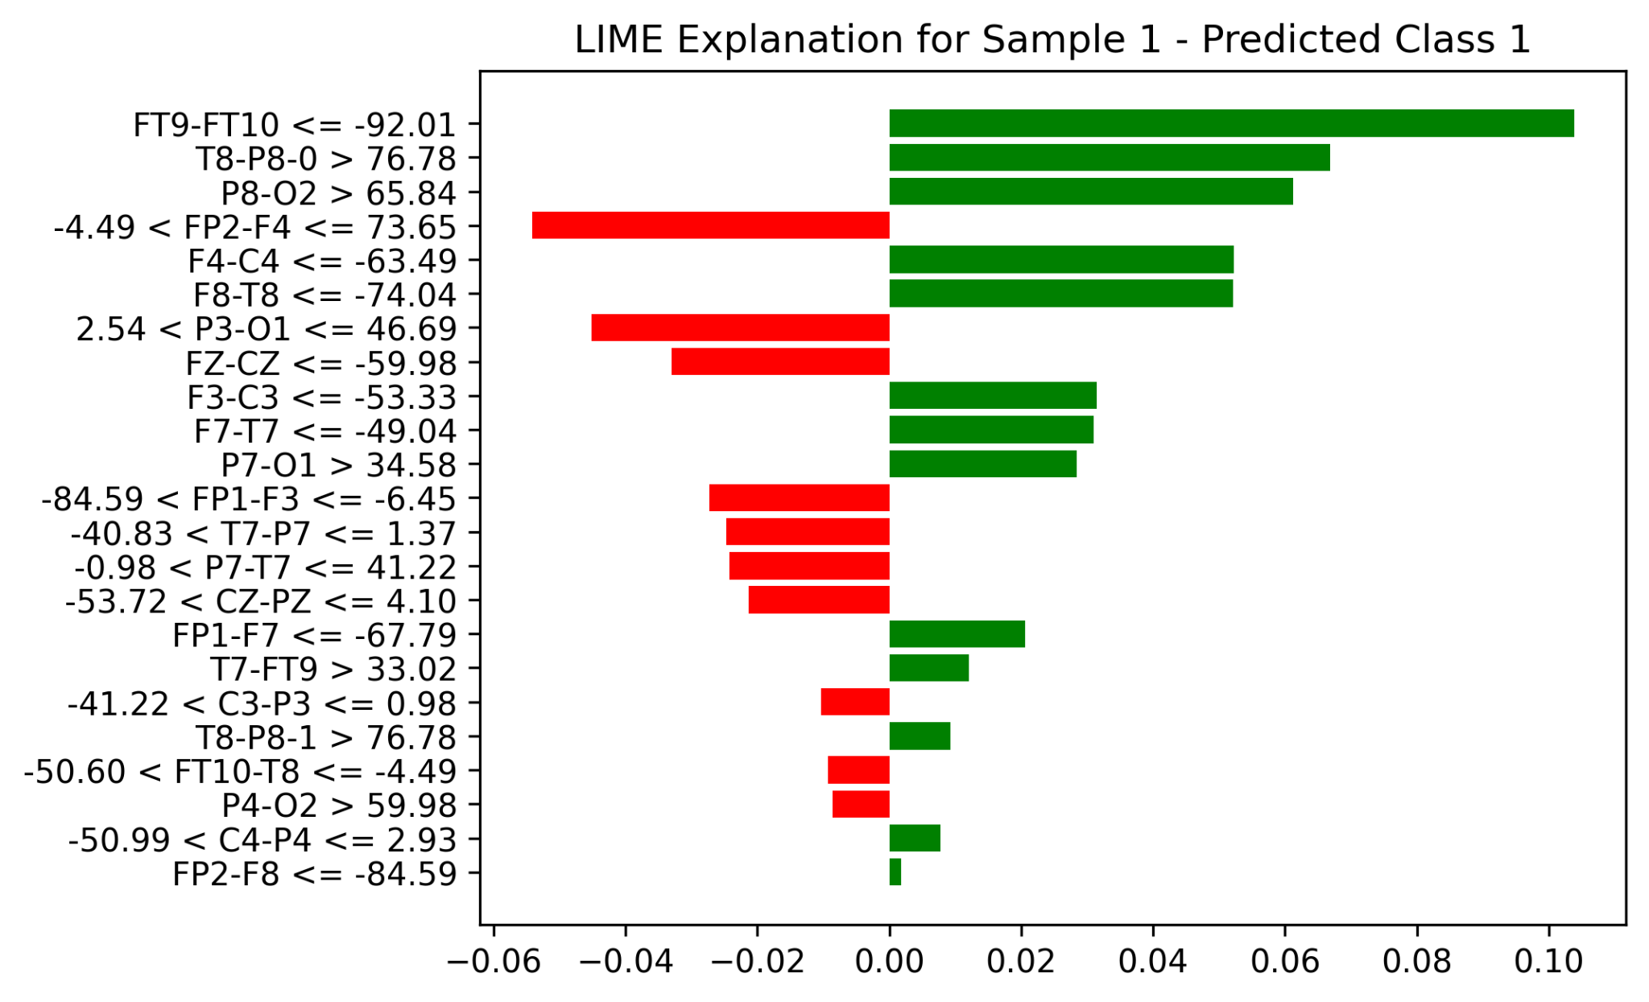
The feature “FT9-FT10 <= -92.01” has the most positive impact on the prediction for Class 1.
The feature “-4.49 < FP2-F4 <=73.65” has the most negative impact on the prediction for Class 1.
The feature “FT9-FT10 <= -92.01” has the most positive impact on the prediction for Class 1.
The feature “-4.49 < FP2-F4 <=73.65” has the most negative impact on the prediction for Class 1.

Slide 48
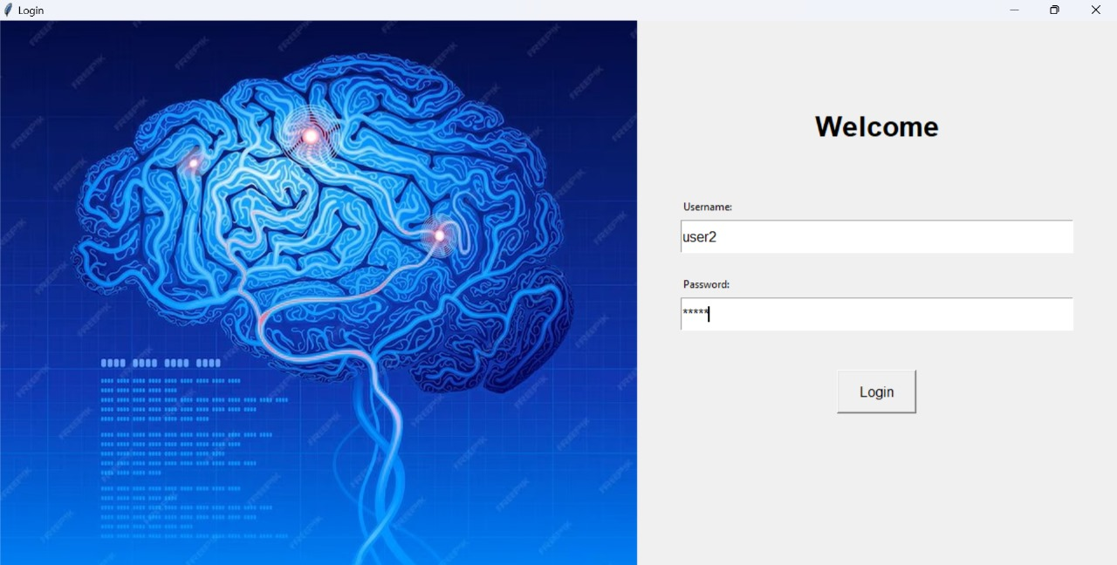
GUI

Slide 49
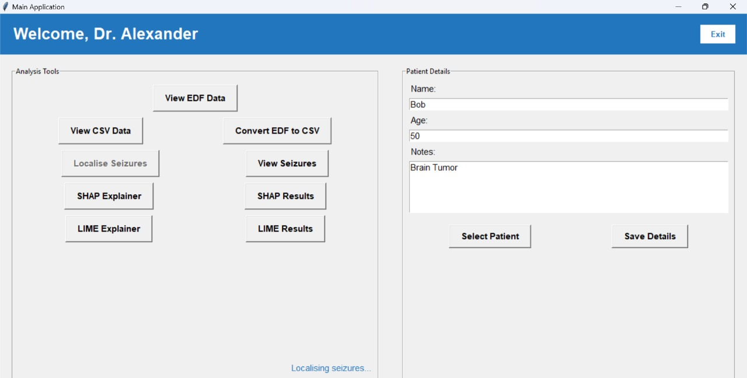
Home page

Slide 50
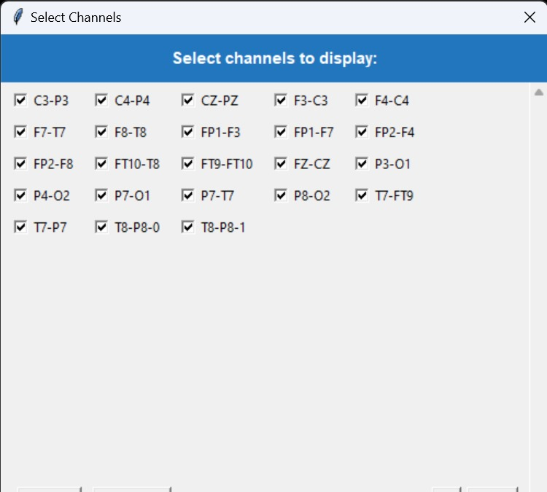
View EDF Files Button:
Option to select the required channels

Slide 51
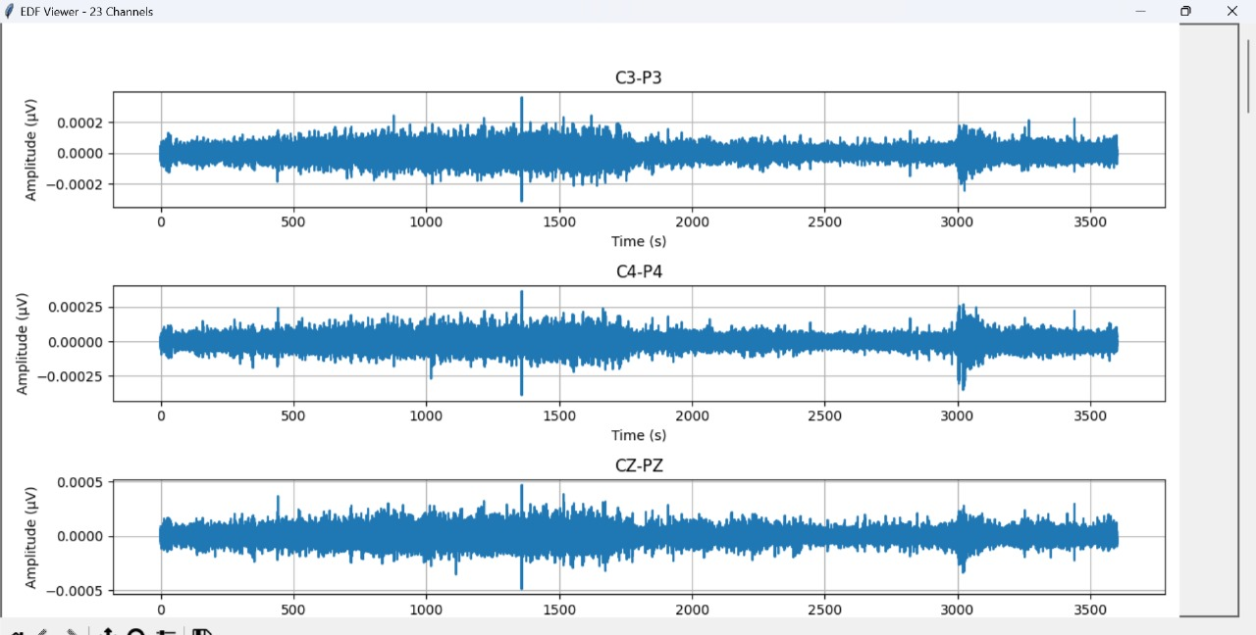
EDF Data Visualised for the selected electrodes

Slide 52
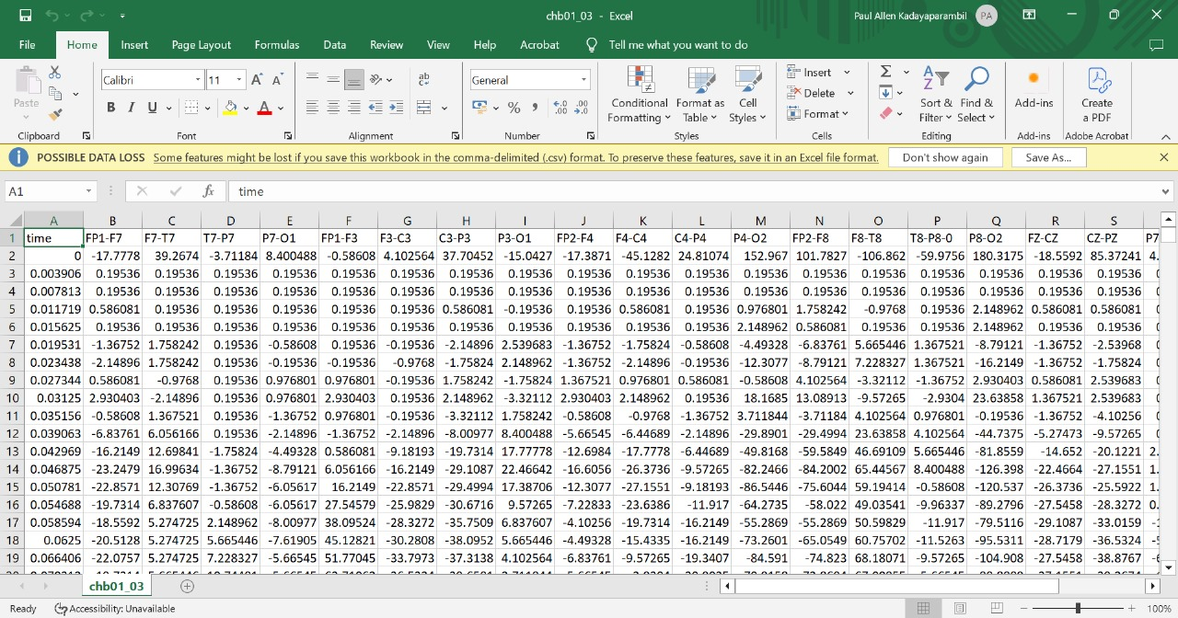
Visualise CSV file button to visualise the EDF files in csv format

Slide 53

Results of time prediction saved in csv files

Slide 54
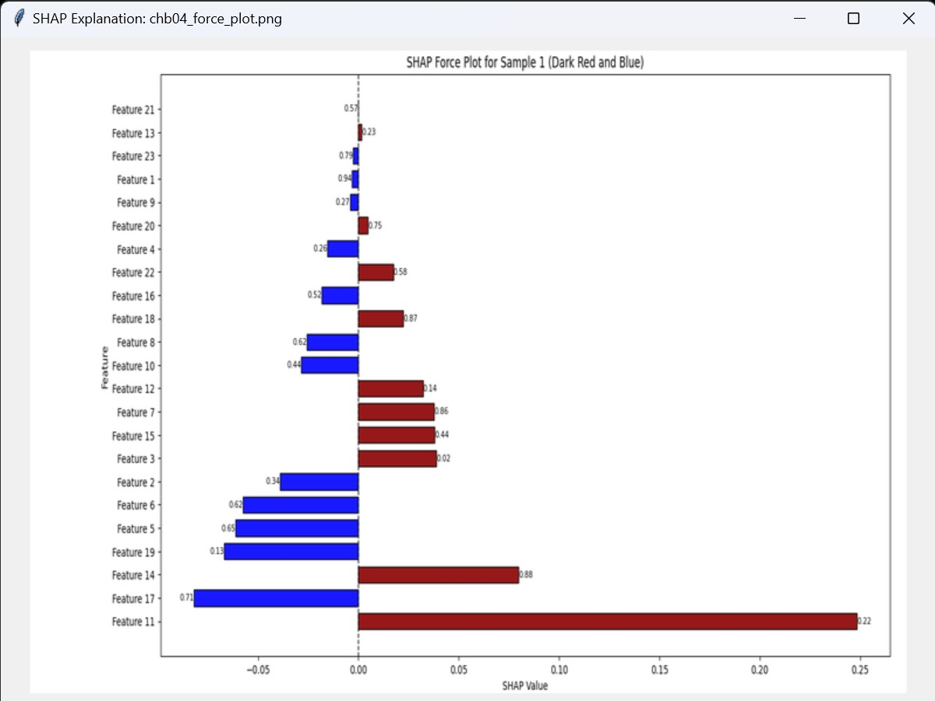
SHAP result for selected seizure of the patient

Slide 55
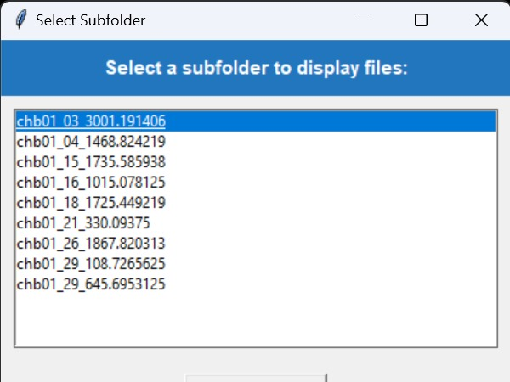
Selection of subfolder for displaying the LIME result

Slide 56
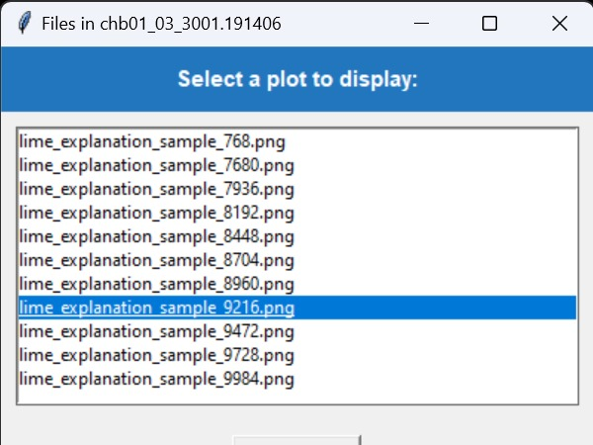
Selection of sample for displaying the LIME result

Slide 57
LIME results visualised

Slide 58
Assumptions
Clean EEG Data: The Bonn University EEG dataset is assumed to be pre-cleaned; preprocessing minimizes noise and artifacts, making it suitable for training.
Patient Variability: While EEG patterns differ across individuals, the CNN is expected to generalize well and correctly identify seizures despite inter-patient differences.
Sufficient Data: The project assumes adequate volume and variety of EEG data for robust training and evaluation of the model.
Computational Resources: Availability of high-performance hardware is assumed for efficient training

Slide 59
Work breakdown & Responsibilities
Feature extraction - Rose Jacob, Powell Moothedan
CNN model - Niyatha V S, Paul Allen Kadayaparambil
Automated time prediction - Niyatha V S
Shapley Additive Explanations - Niyatha V S
Local Interpretable Model-agnostic Explanations - Paul Allen Kadayaparambil
GUI - Powell Moothedan

Slide 60
Hardware & Software Requirements
Hardware:
Minimum: Intel i5 Processor, 8GB RAM, and 256GB SSD for basic model training.
Recommended: NVIDIA GTX 1060 or better for accelerated deep learning training.
Storage: Large enough storage to accommodate EEG datasets (at least 400GB).
Cloud Option: Google Colab or AWS for cloud-based model training using GPUs.

Slide 61
Hardware & Software Requirements
Software:
Operating System: Windows 10, Linux, or macOS.
Programming Language: Python 3.7+.
Libraries:
TensorFlow/Keras: For CNN model building.
SHAP, LIME, GradCAM: For explainability.
Matplotlib and Seaborn: For visualization of model performance.
Scikit-learn: For model evaluation.
IDE: Visual Studio Code, Jupyter Notebook, or PyCharm for development.

Slide 62
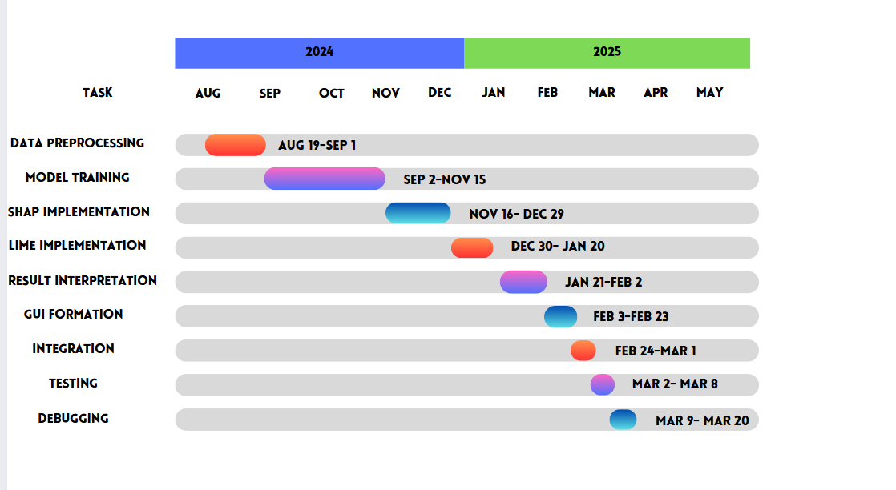
Gantt Chart

Slide 63
Risks and Challenges
Generalizability Across Patients: EEG patterns vary significantly between individuals; the model might struggle with unseen patient profiles, affecting reliability.
Data Imbalance: Seizure events are often rare compared to normal brain activity, which can lead to biased training and poor sensitivity to seizure detection.
Overfitting: With limited or homogeneous data, the model may overfit to specific patterns and fail to perform well on new data.
Computational Constraints: Training deep learning models and running XAI methods require significant processing power, which may not be feasible in all clinical settings.

Slide 64
Expected Output
Generalizability Across Patients: EEG patterns vary significantly between individuals; the model might struggle with unseen patient profiles, affecting reliability.
Data Imbalance: Seizure events are often rare compared to normal brain activity, which can lead to biased training and poor sensitivity to seizure detection.
Overfitting: With limited or homogeneous data, the model may overfit to specific patterns and fail to perform well on new data.
Computational Constraints: Training deep learning models and running XAI methods require significant processing power, which may not be feasible in all clinical settings.

Slide 65
Results
The developed 2D CNN model has an accuracy of 0.98
Alpha Band Slowing Observed
Clear reduction in alpha band power during ictal intervals, especially in ictal regions—consistent with known neurophysiological signatures of seizures.
Demonstrates model's alignment with clinical observations.
Statistical Thresholding for Seizure Interval Detection
Automates the identification of seizure time windows across patients.
Reduces subjectivity and manual tuning; ensures data-driven, patient-specific thresholding.

Slide 66
Results
SHAP (SHapley Additive exPlanations)
Used for global feature attribution, indicating which EEG channels contribute most to seizure prediction.
SHAP values show channel-wise importance over time
LIME (Local Interpretable Model-agnostic Explanations)
Provides local, instance-specific explanations by approximating the model with a linear surrogate.
Visualizations show which features influenced individual predictions, with class-wise contribution strength.
Helps clinicians validate whether model reasoning aligns with physiological patterns for a given EEG snippet.

Slide 67
Future Scope
Integration of Diverse Datasets
Extend evaluation across large-scale public EEG datasets like TUH, EPILEPSIAE, and iEEG.org to validate generalizability across demographics and recording setups.
Incorporate multimodal data (e.g., ECG, video EEG) for richer seizure context and prediction accuracy.
Real-Time Seizure Alert System
Transform the model into an edge-deployable version for real-time monitoring and seizure alerting.
Integrate with wearable EEG devices or hospital systems for continuous patient supervision.

Slide 68
Future Scope
Extension to Other Neurological Conditions
Adapt framework to detect and explain abnormal brain activity in conditions like sleep disorders, stroke, or Alzheimer's disease.
Customizable for other signal-based biomedical applications (e.g., EMG for movement disorders).
Personalized Seizure Forecasting
Incorporate temporal patterns, circadian rhythms, and patient-specific biomarkers to forecast seizures rather than just detect them.
Potential integration with patient diaries and medication schedules for tailored predictions.

Slide 69
Conclusion
Work Completed: We have successfully completed data preprocessing, feature extraction, and CNN model training. Additionally, we have implemented SHAP and LIME for explainability and also have done work on threshold fixing and GUI.
Future scope: The future scope involves generalising the model on various datasets and include real time localisation if possible.

Slide 70
References
M. Xu, P. Wei, S. Yan, X. Gong, and Y. Zhao, "Research Progress on Intelligent Diagnosis of Epilepsy Based on EEG Signals": This paper reviews the advancements in intelligent diagnosis of epilepsy using EEG signals. It focuses on how machine learning and neural network techniques have been applied to improve seizure detection and diagnosis accuracy.
G. Shi, T. Wang, S. Xie, et al., "Deep Learning-Based Methods for Seizure Detection Using EEG Signals: A Comprehensive Survey": This comprehensive survey covers various deep learning approaches used for seizure detection via EEG signals. It evaluates the effectiveness of models like CNNs and RNNs in identifying epileptic events.
A. L. Rodriguez, M. H. Taha, and J. B. Porras, "EEG Seizure Prediction Based on Enhanced Deep Learning Models and Information Theoretic Approaches": The paper discusses seizure prediction methods using EEG signals, enhanced by deep learning models and information theory techniques to predict seizure onset.

Slide 71
References
Schirrmeister, R.T., Gemein, L.A., Eggensperger, K., Hutter, F. and Ball, T., "XAI4EEG: Spectral and Spatio-Temporal Explanation of Deep Learning-Based Seizure Detection in EEG Time Series": This research introduces XAI techniques for explaining how deep learning models detect seizures using spectral and spatio-temporal EEG features, providing greater transparency in model decision-making.
X. Alphonse Inbaraj and Jyh-Horng Jeng, "Mask-GradCAM: Object Identification and Localization of Visual Presentation for Deep Convolutional Network": This paper introduces Mask-GradCAM, a technique that enhances object identification and localization in deep convolutional networks, useful for improving interpretability in vision models.
Marco Tulio Ribeiro, Sameer Singh, and Carlos Guestrin, "Why Should I Trust You?": Explaining the Predictions of Any Classifier: This influential paper introduces the LIME (Local Interpretable Model-agnostic Explanations) framework, which provides human-interpretable explanations for the predictions made by black-box machine learning models.

Slide 72
Thank You

